Slide 1
Total Quality Management (TQM)
Cdr. Vijay Pratap Singh, Adjunct Professor

Slide 2
TOTAL QUALITY MANAGEMENT
Total Quality Management is a management approach that originated in the 1950's and has become more popular since early 1980’s.
Total Quality is a description of the culture, attitude and organization of a company that strives to provide customers with products and services that satisfy their needs.

Slide 3
TQM Defined
TQM is a management philosophy that seeks to integrate all organizational functions (marketing, finance, design, engineering, and production, customer service, etc.) to focus on meeting customer needs and organizational objectives.

Slide 4
TQM contd…
Total Quality Management (TQM) is a method by which management and employees can become involved in the continuous improvement of the production of goods and services.
It is a combination of quality and management tools aimed at increasing business and reducing losses due to wasteful practices.

Slide 5
TQM contd..
Some of the companies who have implemented TQM include Ford Motor Company, Phillips Semiconductor, SGL Carbon, Xerox, Motorola and Toyota Motor Company etc.
Ford operating losses were $3.3 billion in 1980-82.
Xerox market share dropped from 93% to 40% from 1971 to 1981.

Slide 6
Total Quality Management
Continuous improvement must deal not only with improving results, but more importantly with improving capabilities to produce better results in the future.
The five major areas of focus for capability improvement are:-
demand & supply generation
  technology, operations and people capability
A central principle of TQM is that mistakes may be made by people, but most of them are caused, or at least permitted, by faulty systems and processes.
The root cause of such mistakes can be identified and eliminated, and repetition can be prevented by changing the process.

Slide 7
Total Quality Management
There are three major mechanisms of prevention of mistakes in process:
  Preventing mistakes (defects) from occurring (Mistake- proofing or Poka-Yoke).
  Where mistakes can't be absolutely prevented, detecting them early to prevent them being passed down the value added chain (Inspection at source or by the next operation).
  Where mistakes recur, stopping production until the process can be corrected, to prevent the production of more defects. (Stop in time).

Slide 8
Goal of TQM
“Do the right things right the first time, every time.”
All managers and officers of the companies or organisations endeavour to achieve mainly two objectives as indicated below: -
  Total customer satisfaction
  Continuous improvement

Slide 9
Principles of TQM
The key principles of TQM are as following:
Management Commitment
  Plan (drive, direct)
  Do (deploy, support, participate)
  Check (review)
  Act (recognize, communicate, revise)
Employee Empowerment
  Training
  Suggestion scheme
  Measurement and recognition
  Excellence teams

Slide 10
Principles of TQM contd…
Fact Based Decision Making
  SPC (Statistical Process Control)
  DOE: Design of Experiments (DOE) is a set of statistical tools for planning, executing, analyzing, and interpreting experimental tests to determine the impact of process factors adopted on the outcomes of process.
  FMEA: Failure Mode and Effects Analysis (FMEA) is an analytical method in quality management to find out possible product defects before they occur.
  The 7 statistical tools.
  TOPS (Team Oriented Problem Solving): FORD 8D (08 disciplines of problem solving)

Slide 11
Principles of TQM Contd….
Continuous Improvement
  Systematic measurement and focus on Cost of Non Quality (CONQ) (measure of costs specifically associated with the achievement or non-achievement of product or service quality)
  Excellence teams
  Cross-functional process management
  Attain, maintain, improve standards
Customer Focus
  Supplier partnership
  Service relationship with internal customers
  Never compromise quality
  Customer driven standards

Slide 12
Various areas of TQM
Total Quality Control (TQC)
Total Quality Improvement(TQM)
Service Quality Improvement
Quality Maintenance System(QMS)
Software Quality Assurance(SQA)

Slide 13
Quality Control
Industrialization (Mass production)
Inspection
Statistical Process Control (SPC) was introduced in 1924 by Walter A. Shewhart (an American Physicist, Engineer and statistician).

Slide 14
Quality Management
Improvement Plan at all levels of organization
Internal Motivation
Preventive practice

Slide 15
Quality Improvement
Utilizing Statistical Process Control (SPC) that monitors manufacturing processes with technology and measures & controls the quality.
Improving processes.
Reducing waste.
Individual Improvement projects
Monitoring variations

Slide 16
Quality Assurance
George Edwards (inventor of the term)
Assuring quality
Standardization
Quality Policies
Division of responsibility

Slide 17
Quality Management System
ISO 9000 is to develop a quality management system based on the good practices in the previous three steps.

Slide 18
Total Quality Management
All aspects of organization adopting continuous improvement
Change of organizational culture (shift from internal measures of efficiency towards assessment and improvement of value to the customers

Slide 19
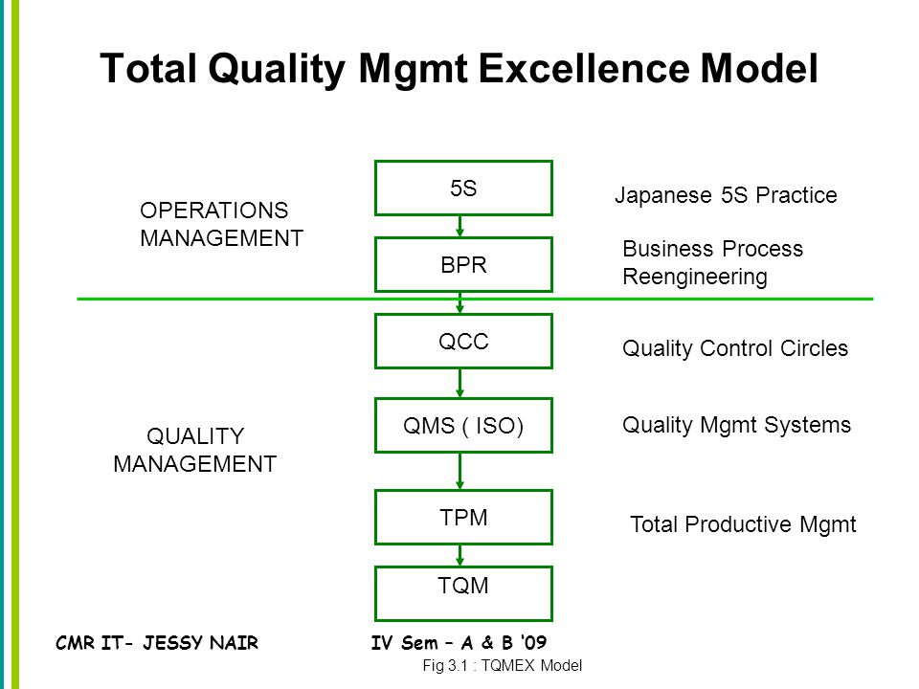
The TQMEX Model
(TQM’s Excellence Model)

Slide 20
Logic of TQMEX
In order to have a systematic approach to TQM, it is necessary to develop a conceptual model.
The idea was to develop a universally applicable step-by-step guidelines by including recognised practices in TQM.
Japanese 5-S Practice (5-S)
Business Process Re-engineering (BPR)
Quality Control Circles (QCCs)
Quality Management System (ISO 9001/2 )
Total Productive Maintenance (TPM)

Slide 21
5-S (Japanese Technique)
Japanese | English | Meaning | Typical Example
Seiri | Structurize | Organization | Throw away rubbish
Seiton | Systemize | Neatness | 30-second retrieval of a document
Seiso | Sanitize | Cleaning | Individual cleaning responsibility
Seiketsu | Standardise | Standarization | Transparency of storage
Shitsuke | Self-discipline | discipline | Do 5-S daily

Slide 22
How to implement 5-S in organization
Step 1 – get the commitment of the top management and be prepared
Step 2 – draw up a promotional campaign
Step 3 – keep records
Step 4 – 5-S training
Step 5 – evaluation

Slide 23
BPR( Business Process Reengineering)
BPR is concerned with re-defining and designing your business process in order to meet the needs of your customers effectively.
It is more concerned with the business objectives and systems, and should follow as Step 2
Managers will rethink their traditional work methods and commit themselves to a customer focused process.
BPR helps to cope with radical changes in technology and competitive pressures.

Slide 24
QCC(Quality Control Circles)
QCCs are concerned with encouraging the employees to participate in continuous improvement and guide them through.
They improve human resources capability to achieve the business objectives.
A small group of people usually from the same work area working together voluntarily to contribute to the identification, analysis and solution of work related problems and the improvement of the enterprise.
The Seven quality control tools: MAGNIFICENT SEVEN

Slide 25
TPM (Total Productive Maintenance)
TPM is a result of applying 5-S to equipment based on a sound quality management system.
TPM is a system of maintenance covering the entire life of equipment in every division, including planning, manufacturing and maintenance.
In fact ISO 9001 requires procedures for process control and inspection and testing equipment which are part of TPM. Therefore TPM should be implemented in Step 5.

Slide 26
Stages of TQM
Quality Control
Monitoring variations
Quality Assurance
Standards based
Quality Improvement
Process oriented
Quality Management
Internally motivated
Total Quality Management
Changed organizational culture

Slide 27
Managing TQM
What Does the TQM manager Need to Know?
  Systems Thinking
  Understanding Variations
  Organizational Psychology

Slide 28
What Does the TQM manager Need to Know?
Systems Thinking
Effective Management
Understanding Variations
Organizational Psychology

Slide 29
Systems Theory
Inputs
Outputs
Supplies
Process
Customers
Feedback Loop

Slide 30
Understanding Variations
Special cause variation
Common cause variation
Interpretation errors
Process capability
Example of probability (coin flipping)

Slide 31
Individual and Organizational Psychology
Efficiency
Work place harmony
Characteristic requirements of a person for a specific job

Slide 32
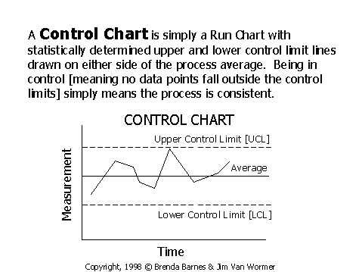
Control Chart
A Control Chart is simply a Run Chart with statistically determined upper and lower limit lines drawn on either side of the process average. Being in control (means no data points fall outside the control limits) simply means the process is consistent and error free.

Slide 33
What Does the TQM Manager Need To Do?
Dr. W. Edwards Deming’s 14 points of management
Create constancy of purpose towards improvement of product and service, with a plan to become competitive and to stay in business.
Adopt the new philosophy.
Cease dependence on mass inspection.
End of the practice of awarding business on the basis of price tag alone.
Improve constantly and forever the system of production and service.
Institute training.

Slide 34
Dr. W. Edwards Deming’s 14 points of management contd…
Institute leadership.
Drive out fear
Break down barriers between department
Eliminate slogans, exhortations and numerical goals that ask for new levels of productivity without providing methods.
Eliminate numerical quotas.
Remove barriers to pride of workmanship.
Institute a vigorous program of educations and retraining.
Take action to accomplish the transformation.

Slide 35
KAIZEN (Japanese management philosophy)
KAIZEN means improvement.
It means ongoing improvement involving, everyone, including managers and workers.
Kaizen and World war II.
Kaizen is an umbrella concept covering most of the Japanese practices that have recently achieved such worldwide fame.
Kanban- Just in time production

Slide 36
Q & A session

